Slide 1
Golang Training
24/01/2023

Slide 2
Golang Overview
Go was designed in Google in 2007
Open Sourced in 2009
Why Go?
Why one more new programing language?
What is the Purpose?
How it is better or Different?
Features of Go
Statically typed
Garbage Collection
Go standard library
Concurrency Support
Type Safety
Rich open-source package
2

Slide 3
Go Installation
What you need to run Go Programs?
Go Compiler
https://go.dev/doc/install
Editor
https://code.visualstudio.com/download
Quick trail
Go playground:
https://go.dev/play/
Go standard library:
https://pkg.go.dev/std
Documentation
https://go.dev/doc/
Quick Help
https://go.dev/doc/effective_go
3

Slide 4
Golang vs Other Languages
Golang Vs C++
https://github.com/mail2sada/GolangTraining/blob/main/GolangTrainingMaterial.xlsx
Golang vs JAVA
https://github.com/mail2sada/GolangTraining/blob/main/GolangTrainingMaterial.xlsx

Slide 5
Hello world with Go...
Go source files have .go extension
Every source file is part of a package
Execution of go begins with main package.
Function main() is the entry point of the code.
Importing packages
Hello word..
https://github.com/mail2sada/GolangTraining/blob/main/Day1/Day1Src/helloworld.go
5

Slide 6
Go Code Structure
Go code is always packaged in package
Go code begins its execution from main function in main package
Package name is specified using package keyword
Syntax
Package can be imported using import key word
Syntax
package "package-name"
Import "package-name"
6

Slide 7
Packages and Modules
Package is a way to reuse the code
Package is way to group code
Eg. math package having functions related with maths
Every go source(.go) belongs to a package
Go source code will have first line as package, indicates source code in the belonging to package
Specified with key word package <package_name>
7

Slide 8
Packages types
Package are of 2 types
Executable package
Utility Package
Executable package
Package main is the only executable package.
Utility Package
Any package other than main package is a utility package
8

Slide 9
Modules
Module is go support for dependency management
Module is a collection of related packages with go.mod at its root
Modules are managed by go.mod file
Module dependency is also managed by go.sum file
Contains cryptographic hash of bits of all project’s dependent modules
9

Slide 10
go.mod
Go.mod is a module dependency file
Import path of the module at the top
The version of go with which the module is created
Direct dependencies of the module.
Below command can be used to create a module
go mod init {module_import_path}
10

Slide 11
go.sum
Lists down the checksum of direct and indirect dependency required along with the version
go.sum file is used to validate the checksum of each direct and indirect dependency.
11

Slide 12
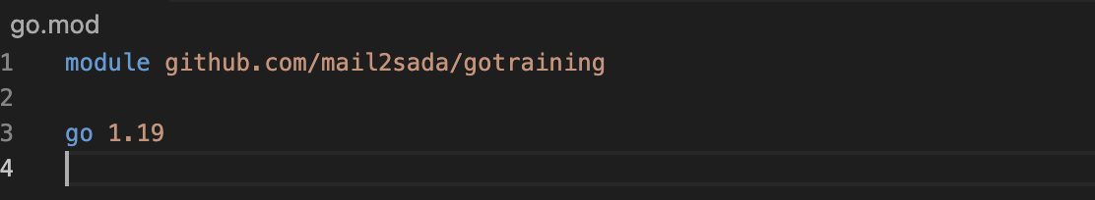
Importing modules
Modules are imported using import path
go mod init {module_import_path}
Eg. go mod init github.com/learn
export GO111MODULE=auto
go mod init "github.com/mail2sada/gotraining"
12

Slide 13
Importing modules
Import path of the module at the top
module github.com/mail2sada/gotraining
Version of go with which the module was created
go 1.19
13

Slide 14
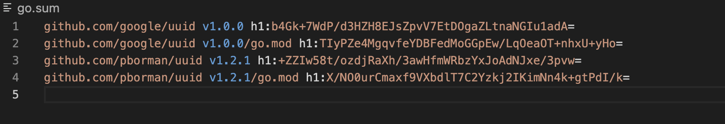
go.sum
14

Slide 15
Package:Some Info
Creating user defined packages
Importing package
Exported and UnExported methods
Nested packages
Alias importing...
Init functions
Using external packages (go get)
Blank Identifier in import
Importing from external module
Performing go get on our module...
15

Slide 16
Package:Order of Execution
The program starts with the main package
All imported packages in the source files of the main package are initialized
Then global variables declaration in these packages is initialized
After this, init() function is run in these packages
Global variables in the main package are initialized
Init() in the main package is run if present
main function in main package is run.
go mod help
16

Slide 17
Package:Naming convention
Underscore in the package name
Camel casing or any kind of mixed caps
17

Slide 18
Package:Naming convention
Underscore in the package name
Camel casing or any kind of mixed caps
18

